Slide 1
Data Science Class 1
Puranjit Singh
09/01/2021

Slide 2

What is Python
Python is a general purpose, high level, interpreted language with easy syntax and dynamic semantics
Created by Guido Van Rossum in 1989
Python's simple, easy to learn syntax emphasizes readability and therefore reduces the cost of program maintenance.
https://www.iconfinder.com/icons/4375050/logo_python_icon
Notes:
Development of this language started as a hobby by its creator Guido Van Rossum because he wanted to build up a language that was easy to develop and easy for everyone who reads it.
The main difference between python and other languages at that time was the difference in its layout. While other languages made use of certain block of codes written in curly brackets while python was developed taking indentations into consideration
It did not gain much popularity at that time due to its new approach but with the emerging era and rise of ML and AI, python has come to the spotlight and its usage in industry and research has outperformed other languages because it makes work much easier and more productive

Slide 3

Why is Python popular?
Applications
Easy
Library and support
Free
Python is the language preferred by beginners and pros alike
Notes:
Easy – easy syntax and high-level features and is usually the best language for one to get started for everybody
Free – It is free and open-source language, and anybody can access and use this language for everybody
Applications – Python has a vast area of applications including desktop, web, mobile application development. Also it is used in building up GUI’s, building ML algo’s, run applications of AI
Library and support – Python has a great community who constantly make libraries and help those in need. For e.g. – ML algo’s are already available on internet and can be used to develop certain models as demand by the user.

Slide 4
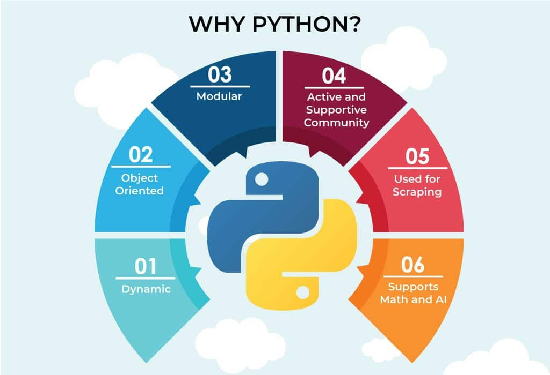
Features of Python
Easy language
Dynamically-Typed language
Object-Oriented
Popular and large source community
Open-source
Large standard library
Platform independent
High level language
https://www.ubuntupit.com/frequently-asked-python-interview-questions-and-answers/
Notes:
Simplicity – It helps you move towards solutions rather than working on syntax resolving issues
Dynamically typed language - Python is not statically-typed like Java. You don’t need to declare data type while defining a variable. The interpreter determines this at runtime based on the types of the parts of the expression. This is easy for programmers but can create runtime errors.
Open-source – free for anyone to use and modifications in python are also allowed without any problems
Platform independent - Python is platform-independent. If you write a program, it will run on different platforms like Windows, Mac and Linux. You don’t need to write them separately for each platform.
Embeddable and extensible – It is quite convenient to import code written in different languages in python which increases its usability and more extensible
Interpreted – Python is a language that is interpreted line by line which means the management of CPU for execution and debugging of code much easier
Huge library – Python has a huge dataset of libraries that can be used for web, mobile development and other ML models
Object orientation – Python is an object-oriented programming language as we can code a real-world problem through our code and prevent its access to others and help make data secure and confidfential
Other features -
GUI programming – You can use python to create GUI’s. Python offers multiple frameworks to develop GUI’s like Tkinter

Slide 5
Applications of Python
Web development
Software development
Big data
Education
Database
Prototyping
Notes:
Python offers many choices for web development:
Python is often used as a support language for software developers, for build control and management, testing, and in many other ways.
Python is a superb language for teaching programming, both at the introductory level and in more advanced courses.
Python is also used to build ERP and e-commerce systems:

Slide 6
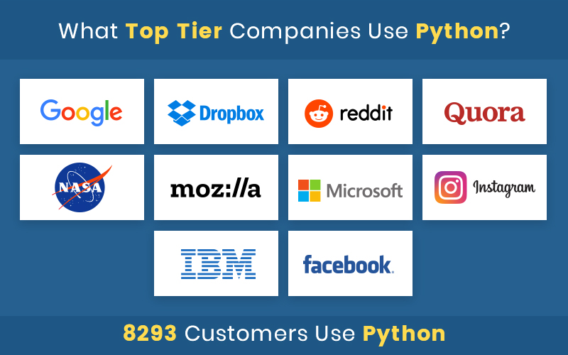
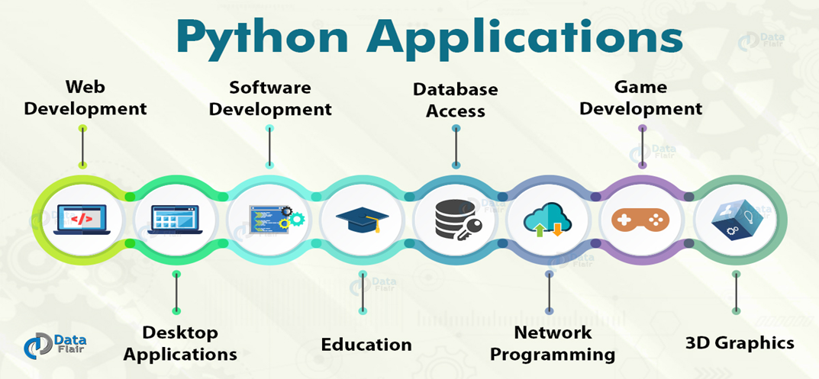
Where is Python used in Industry?
https://data-flair.training/blogs/python-applications/
https://www.bacancytechnology.com/blog/why-python-is-so-popular
Notes:
Google – to provide better search features (core search algorithms are mainly written in Python and C++)
Dropbox – is a cloud platform that helps sharing data between server and clients
Netflix – uses ML algo build in python to find interests of its users and recommend them with suggestions to retain them longer
Quora – uses ML algo’s to find related questions searched by a user to provide a better information and user-friendly platform
NASA – scientific calculations are computed using python (Also, WAS – Workflow automations system for NASA which is fast, cheap and right is build up in Python and it helps them to tackle the complexity of programs within WAS)

Slide 7
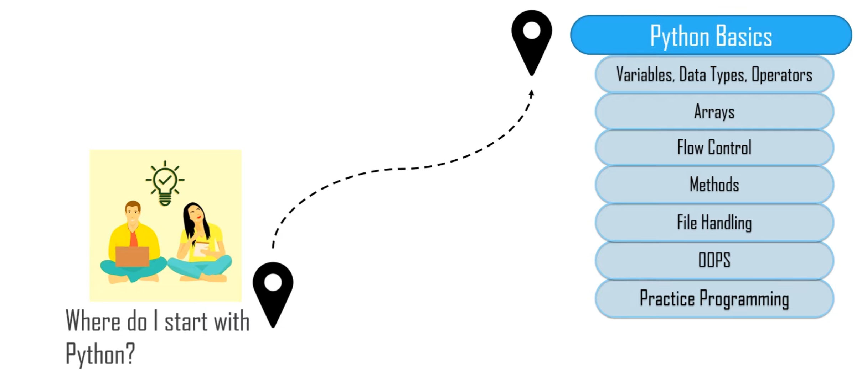
Learning path
https://www.edureka.co/search/python

